Slide 1
Application Development Task #4

Slide 2


BookWorm
The revolutionizing digital ebook library
K.P.I. Shenesh Perera / IDM Negombo
Notes:
BookWorm logo from dribble.com by Patrick Davis

Slide 3
What is BookWorm?
A digital library that holds all of your favorite books!
A cross-platform ad-free reading experience!
A blazing fast and minimalistic beautiful mobile app!
Notes:
Bookworm, the solution to all the problems that a traditional library has. The name of this project was birthed by how my mother nicknamed me a “bookworm” when I was young. The project attempts to solve all the problems mentioned in the problem declaration, in a smart, creative and modern manner.
BookWorm is the one stop for all your digital book needs, it will function utilizing the GooglePlay Books API, grabbing the books that everyone loves to read from Google to present it in a much more friendly and better manner!

Slide 4
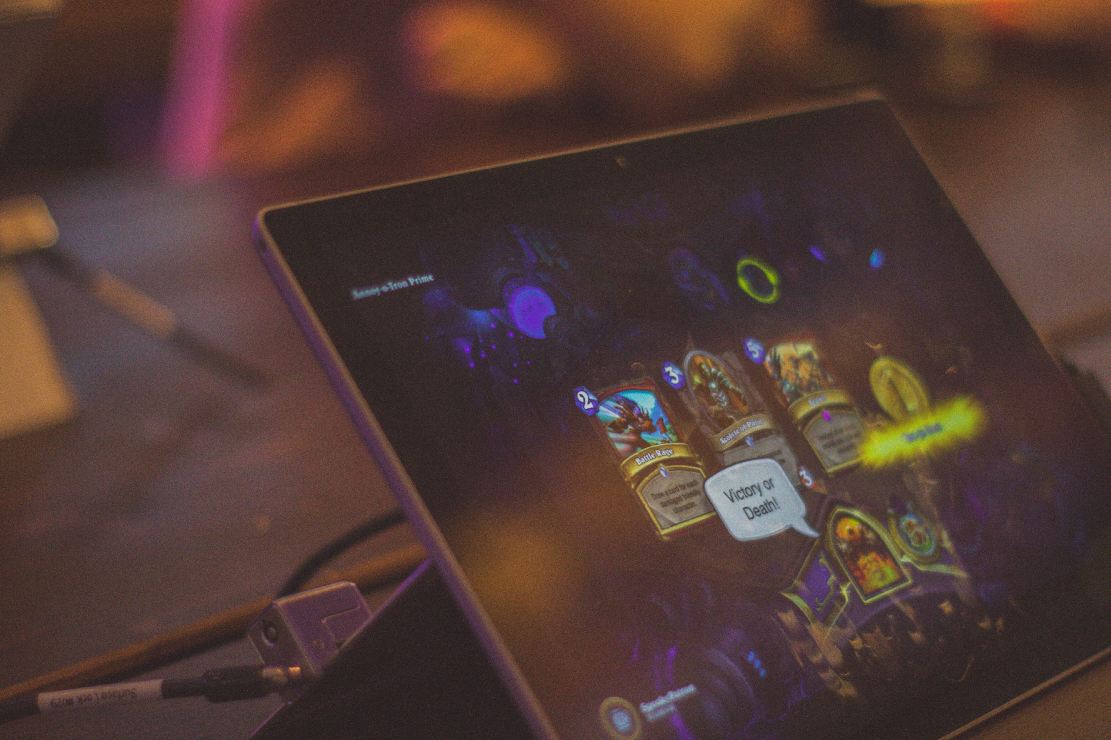
What does BookWorm try to solve?
Traditional libraries are a thing of the past!
They don’t lend books for long periods of time.
You can’t borrow a book from a library without membership.
You have to pay membership costs every month.
Most libraries have old books that most people don’t even read.
Finding a good library is difficult.
You have to go through shelves of books to find a book you want.
But most importantly…
Any book you want is now on the internet!
Notes:
Essentially, the main problem BookWorm attempts to solve is to allow the modern generation of technological book readers to read books at the comfort of their house rather than having to visit and spend time at an inconvenient place such as a library.
The current libraries all have the following problems:
Library memberships are required to take a book home for further reading. Depending on the region the library is, the membership cost maybe expensive.
If in some case a book is damaged, a penalty cost has to be paid. This happens quite often as books are made of paper and paper is quite fragile.
Most libraries do not provide allow their members to keep books with them for extended periods of time, almost all the libraries lend books only for 2 weeks. Exceeding this time period has a penalty, each day that passes the penalty increases.
Libraries hold quite outdated books with outdated knowledge, some may even contain facts that are wrong.
The newest books are usually not available, it takes at least a period of a year for a library to receive a copy of a new book, that too if the library is actually serious about the goal of a library.
Libraries are counted as the “traditional” or “old-fashioned” way of finding or reading books, as such most of the libraries around the island have poor maintenance and support from the community.
Unless the library is sufficiently large and has a lot of backing, it is very likely that the library will not sell books, which in other words means that it is impossible for you to have a book that you have a liking towards forever with you.

Slide 5
5,341,764
Over 5 million books in just a click away!
Only with… BookWorm!

Slide 6
Why should you use BookWorm?
Ad-free
We think about the readers, and by no means will we bombard you with nasty popups or annoying ads!
Dark mode
It’s quite apparent that book lovers read at night, so we have a dark mode, your eyes will thank you!
WYSIWYG
What you see is what you get! We don’t have any hidden layouts so even if you printed it out, you’ll get what you see!
Blazing fast & data-friendly
The app is merely 295KB! Whenever you load the app, it only consumes 2.3MB. We don’t waste your data, we conserve it!
Minimal UI
The user interface of the app is very friendly to users of any technical skill level. It’s clean and looks really good across any platform.
Cross-platform
iOS, Android, Windows, Linux, you name it, we have it! BookWorm runs on mobile and on desktop with no problem at all.

Slide 7
PWA BookWorm = PWA
The key to the performance and cross-comaptibility, is that BookWorm is a Progressive Web Application!
Notes:
Let’s take the example of Whatsapp on your phone. When there is no network, you can still open the app, check past messages and even reply to someone. When the phone gets the internet connection, the messages are being automatically sent in the background.
This is what PWA promises to provide in web apps. It enables web apps to load when there is no network, sync in the background and seamlessly do things while providing a native-like experience for your users.
PWAs make web applications look, feel and behave very closely to that of native applications and as a result you have a blazing fast application in all the platforms that you need to market on.

Slide 8

PWAs are the future of application development
Progressive Web Applications have been noted by Google and other large tech giants to be the best solution to performance, user exeprience and other requirements of an app.
Notes:
Figure 1.1, unsplash.com, Annie Spratt, 15/04/2017
Let’s discuss some of the core attributes which are missing from common non-progressive web applications.
Reliable - Apps should be lightning fast when loading, it should be close to instantaneous and should also open when there is no network or fairly low-speed network like 2G. Google found that 53% of the users abandon the website if the page took longer than 3 seconds to load.
Fast - The scrolls and page transitions should be buttery smooth when the user is interacting with the web app. Everyone hates crappy scrolls.
Responsive - The app should fit in all the different sizes of devices. The perfect web app should be like liquid, which takes the shape of its vessel.
Installable - If we want to make web apps closer to the native apps, they have to be installable and should reside in the home screen along with other native apps, so that the user can access the PWA in one click.
Splash Screen - PWAs adds a splash screen during the startup of the app. This makes the PWA feel more like a native app
Highly engageable - The app should keep the users engaged. A PWA provides features like push notification, home screen icon, full-screen and offline first app to glorify user engagement.

Slide 9
How to install BookWorm on mobiles?
VISIT
WEBSITE
CLICK ADD
TO HOME
SCREEN
ENJOY
No complex sign-ups, searching in app stores or lengthy processes of installing APKs!
Why? Because BookWorm is a PWA!
Notes:
The website you have to visit is https://bookwormz.netlify.com.

Slide 10
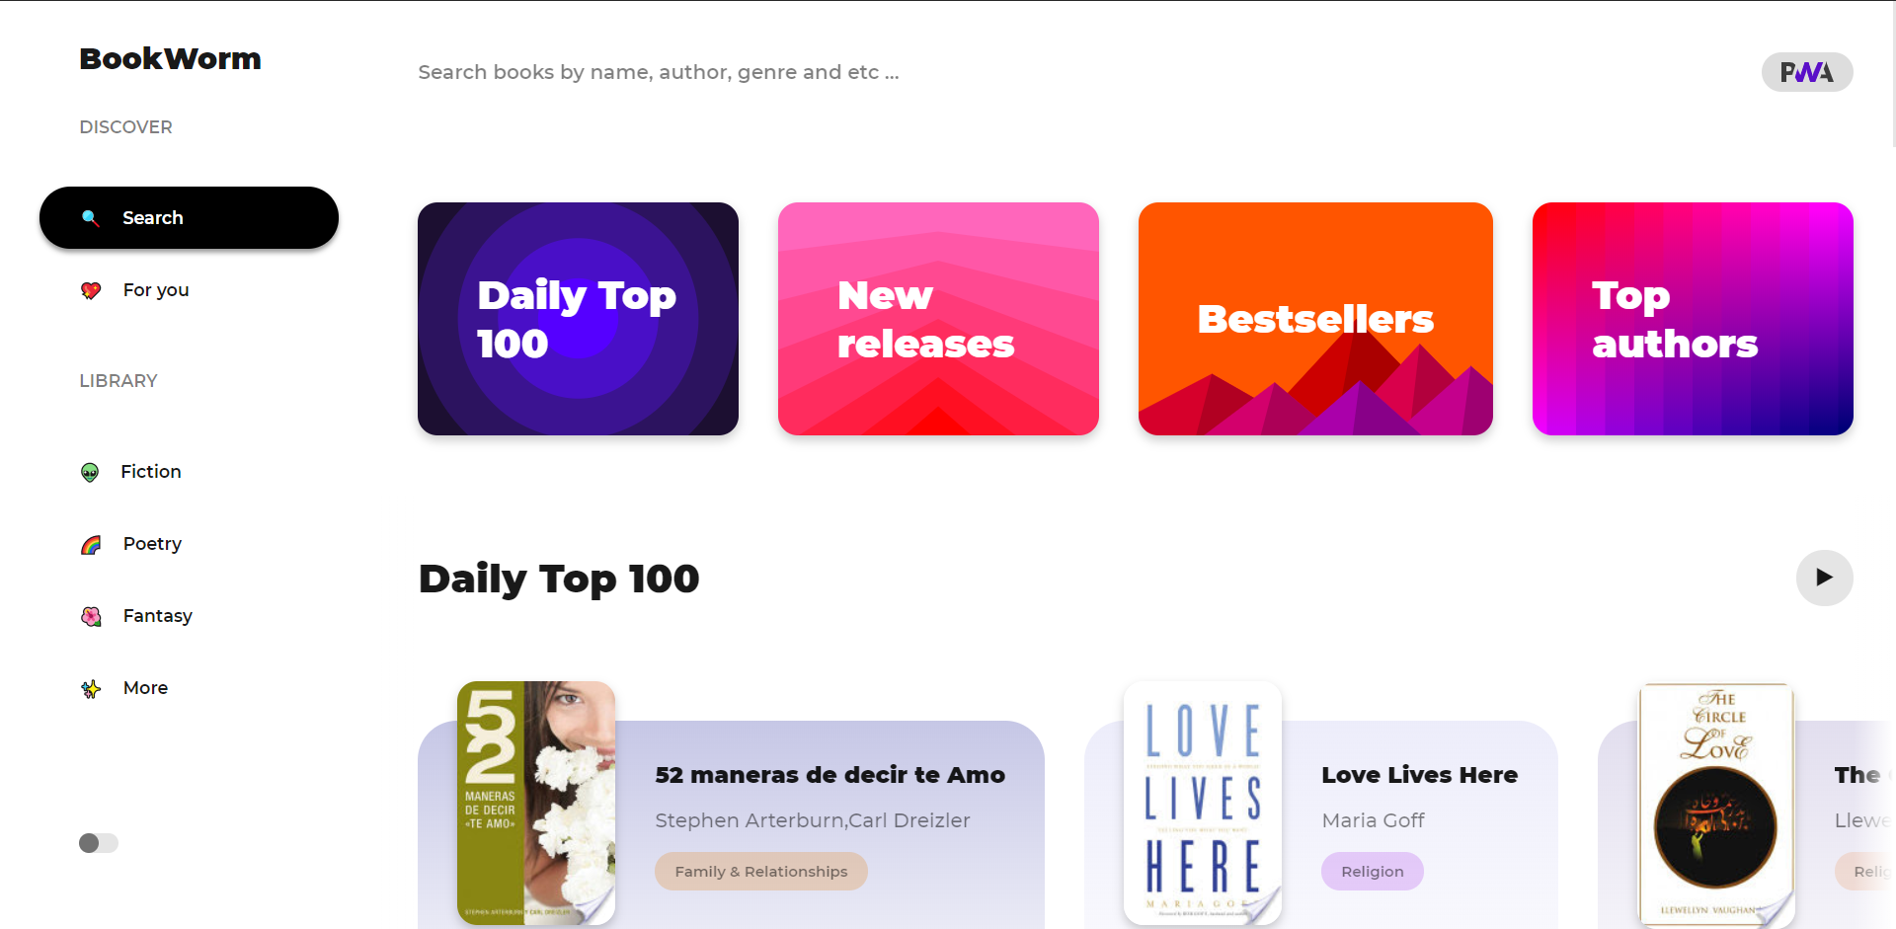
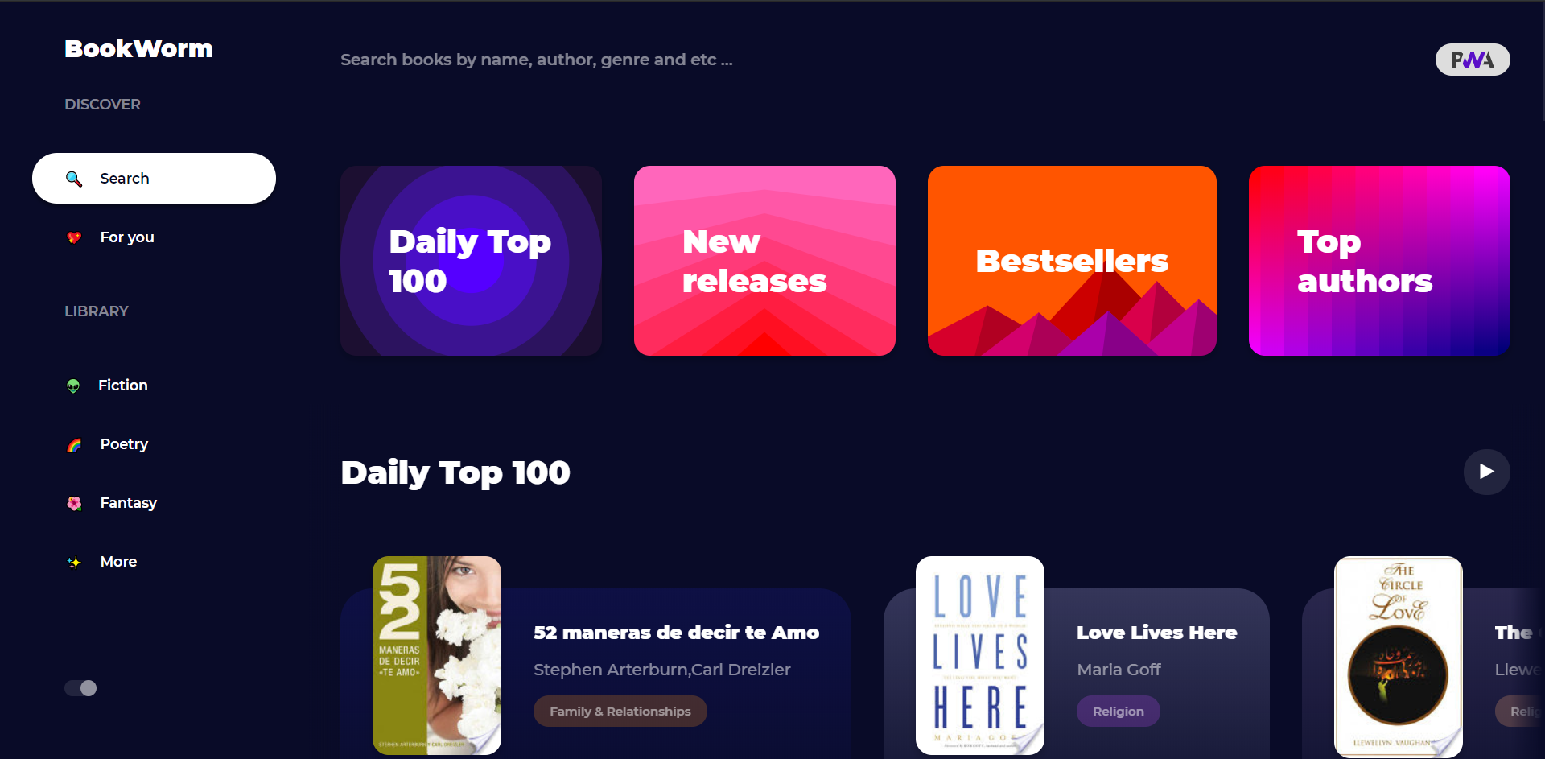
DESKTOP VIEW
BookWorm in all it’s glory! Hosted at bookwormz.netlify.com!
Place your screenshot here

Slide 11
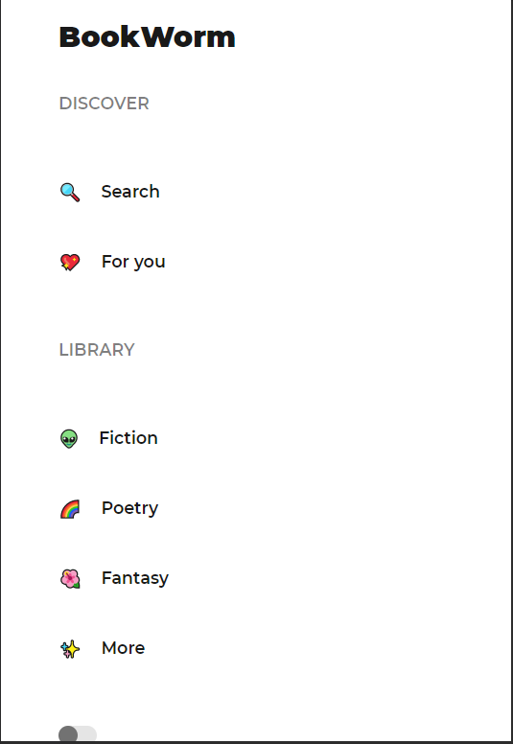
ANDROID VIEW
BookWorm works well and can be installed on all android versions of any brand!

Slide 12
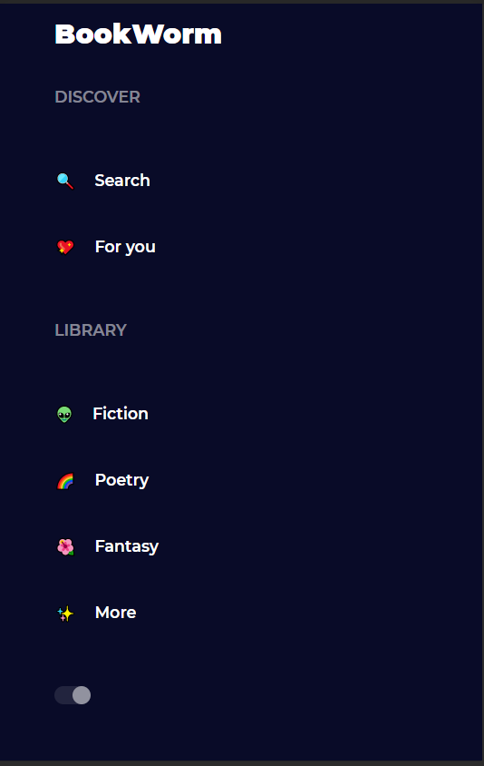
iPHONE VIEW
Do you have an iPhone? No worries! BookWorm is installed from the website, and looks and works great on iOS!

Slide 13
TABLET VIEW
BookWorm runs on all tablet devices of all versions, just look at how great it looks!

Slide 14

DEVELOPMENT STORY
Project Definition – Understanding the business related problem and doing the necessary research involved.
Content Phase – Writing the content that’s required for BookWorm and establishing a sensible sitemap to allow search engines to crawl BookWorm.
Design Phase – Wireframing and establishing a several UI testing methods, ensuring that the design was mobile-first was a big part in this phase.
Development Phase – The actual coding, using the fetch api, workbox service worker api and several other components were written in this stage.
Deployment Phase – Writing the manifest and doing final fixups, ensuring that the application is production ready and then finally deploying to netlify!
BookWorm was a lot of hard work…
Notes:
Figure 1.2, unsplash.com, Kevin Laminto, 11/09/2015
Project Definition, this phase was one of the crucial phases as I had to understand the business related problem, set up a basic set of user and system requirements and grasp the objectives of the business related problem’s solution. Extensive primary and secondary researches were done in order to understand the business related problem and to identify the existing problems in the traditional way of reading books in a library then a problem declaration was drawn.
Content Phase, this was more of a strategy taken in order to ensure that I wouldn’t have to spend a lot of time in the development phase trying to figure out what text will go where and what I will have to come up with. In this stage I birthed the name for the project, BookWorm, declared the sitemap so that search engines can crawl the website and wrote the necessary content required.
Design Phase, this must be the core of the process of the development, it helped me understand how a PWA should look before I actually developed it with the tech stack that I chose to work with. I did some basic wireframing on paper, wrote some basic HTML and did some basic CSS to have a proper structure to work with. One very important thing I did in this phase is making the manifest, which is very important for a PWA to work.
Development phase, the most challenging phase in the entire process. Admittedly, I’ve worked with a lot of fullstack applications, written a several production ready backend and frontend services but this was my first time doing caching and working with the Service Workers introduced the Chrome V8 engine as a result of the ECMAScript 2015 (ES6). Service Workers are the most crucial component in the PWA, working with the Workbox Service worker and maintaining my own service worker were quite the challenge. The necessary testing was also done during this stage.
Deployment phase, by now I had already with me a fully functioning application that satisfied the objectives and fulfilled all the requirements of the business related problem. Now the new problem was to find a suitable service that would help me deploy the PWA, and upon research I came to find Netlify. A great service that serves static serverless architecture based web applications for free with rich features like SSL/TSL support and Continuous Integration(using travis and the like) plus A/B testing.

Slide 15
Technical Difficulties faced
Cache & Cache Invalidation
Service Workers are key in the process of developing a PWA, Service workers exist to do caching and it was quite difficult to get it right.
Insufficient learning resources for PWA development
PWAs are relatively new to the internet, with just being introduced in 2015. Learning materials are quite sparse and among them only few are valuable.
Smooth UX
Ensuring a smooth UX for mobile users in a website has always been a challenge for me. However previous experience was a big help.
Notes:
Not having previous experience with PWAs and insufficient resources to learn from
This was considerably the biggest technical difficulty I faced during the process of doing this project, I had barely any experience with a PWA.
I barely even knew what a PWA is. The topic of progressive web application development is fairly new to this world, as first introduced in 2015 by Alex Russel, the resources that are around the internet to learn to develop a PWA are quite outdated at times and do not cover the full picture.
No browser means no safety net
This isn’t a security issue, this is more of a problem that I had to face regarding the utility functions that are provided by the browser to any website that’s run in the browser. Although this is a good thing on mobile platforms, it is certainly not a good thing for the website that is run on your browser. This is solved easily by adding a navigation bar on the side.
Mobile application-looking navigation
A PWA must look and feel like a general mobile application, so it must retain the position of content and listings of the sort. Users must be capable of navigation to and from the application easily. As the PWA will be run on mobile as a mobile app, it is very important to think about touch interactions.
Caching and cache invalidation
The main purpose of the service worker was to cache static assets, including the html and css files for atleast a week long. The problem with this that I faced is that when the Google Play Books API updated some kind of dynamic content, although the client-side sends HTTP requests to the Google Play Books API through the Fetch API, even if the data is successfully returned, the user interface will not update with the new data as the data that is used is from the cache.

Slide 16
Successes and failures
Successes
Managing to write my first PWA!
Ensuring that the PWA looks good on all devices.
Making the application functional even without internet.
Failures
Relying on the Google Play Books API.
Relying on the Workbox SW API.
Not being able to add a login system.

Slide 17
THANKS!
Any questions?
You can find me at:
Reddit: u/Mydrax
Gmail: sheneshperera23@gmail.com

